Slide 1
Reading and Understanding Food Labels
Developed by: Dr. Keren Dalyot and Yael Rozenblum, Faculty of Education in Science and Technology, Technion

Slide 2
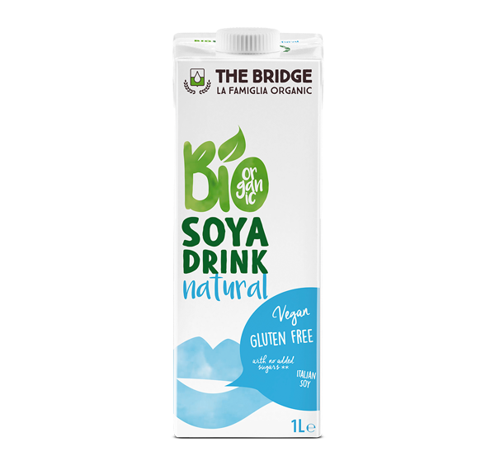
Let’s Guess (1)
Water
Organic decorticated soybeans from Italy (8%)
Sea Salt

Slide 3
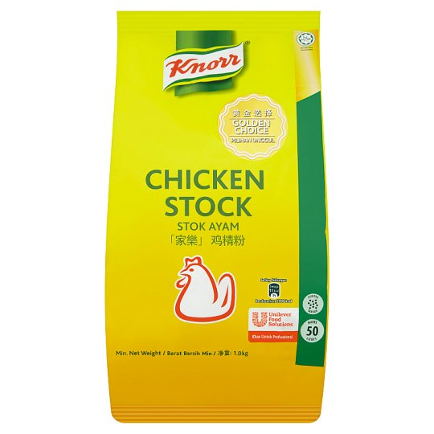
Let’s Guess (2)
Salt
Monosodium Glutamate
Maltodextrin
Cornstarch
Sugar
Chicken
Palm Fat
Hydrolysed Vegetable Protein
Sodium Inosinate
Guanylate
Permitted Flavourings (contains Egg)
Silicon Dioxide
Spices.

Slide 4
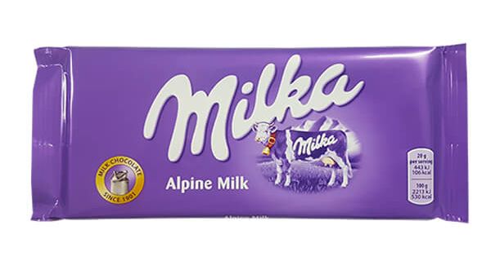
Let’s Guess (3)
sugar
cocoa butter
skimmed milk powder
cocoa mass
whey powder (milk)
milk fat
hazelnut paste
emulsifier (soya lecithin)
artificial flavor

Slide 5
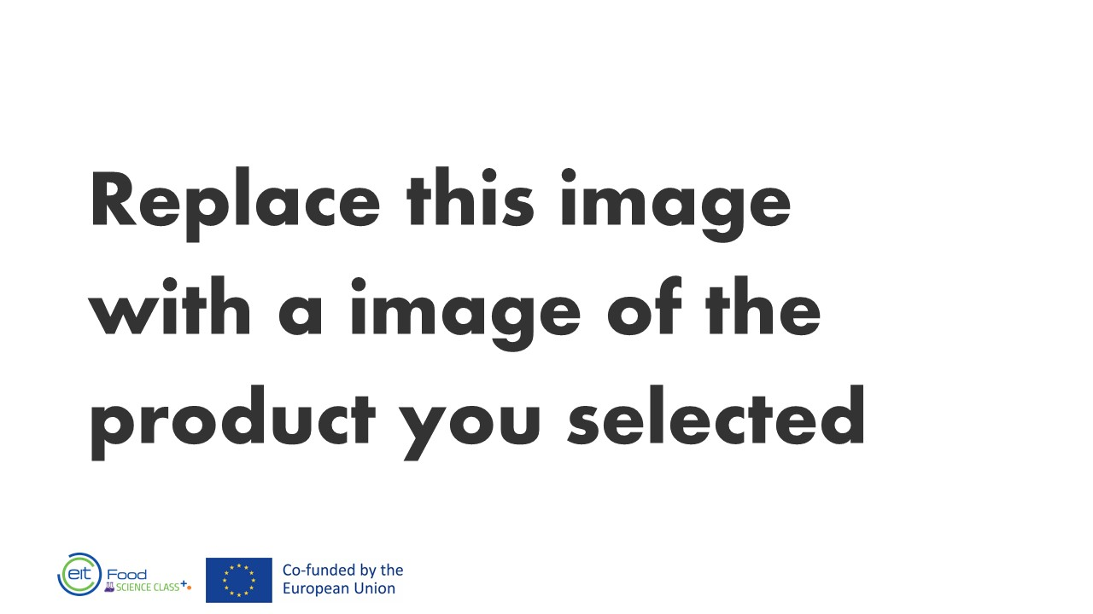
Let’s Guess (4)
Add ingredient list here

Slide 6
Let’s Guess (5)
Add ingredient list here

Slide 7
Let’s Guess (6)
Add ingredient list here

Slide 8
Why do you think it was difficult (or sometimes easy) to identify the products?
?

Slide 9
What we will talk about:
What information appears on food packaging?
How to decipher the ingredients list
How to decipher nutritional labeling
Use by, Best before - what do they mean?

Slide 10
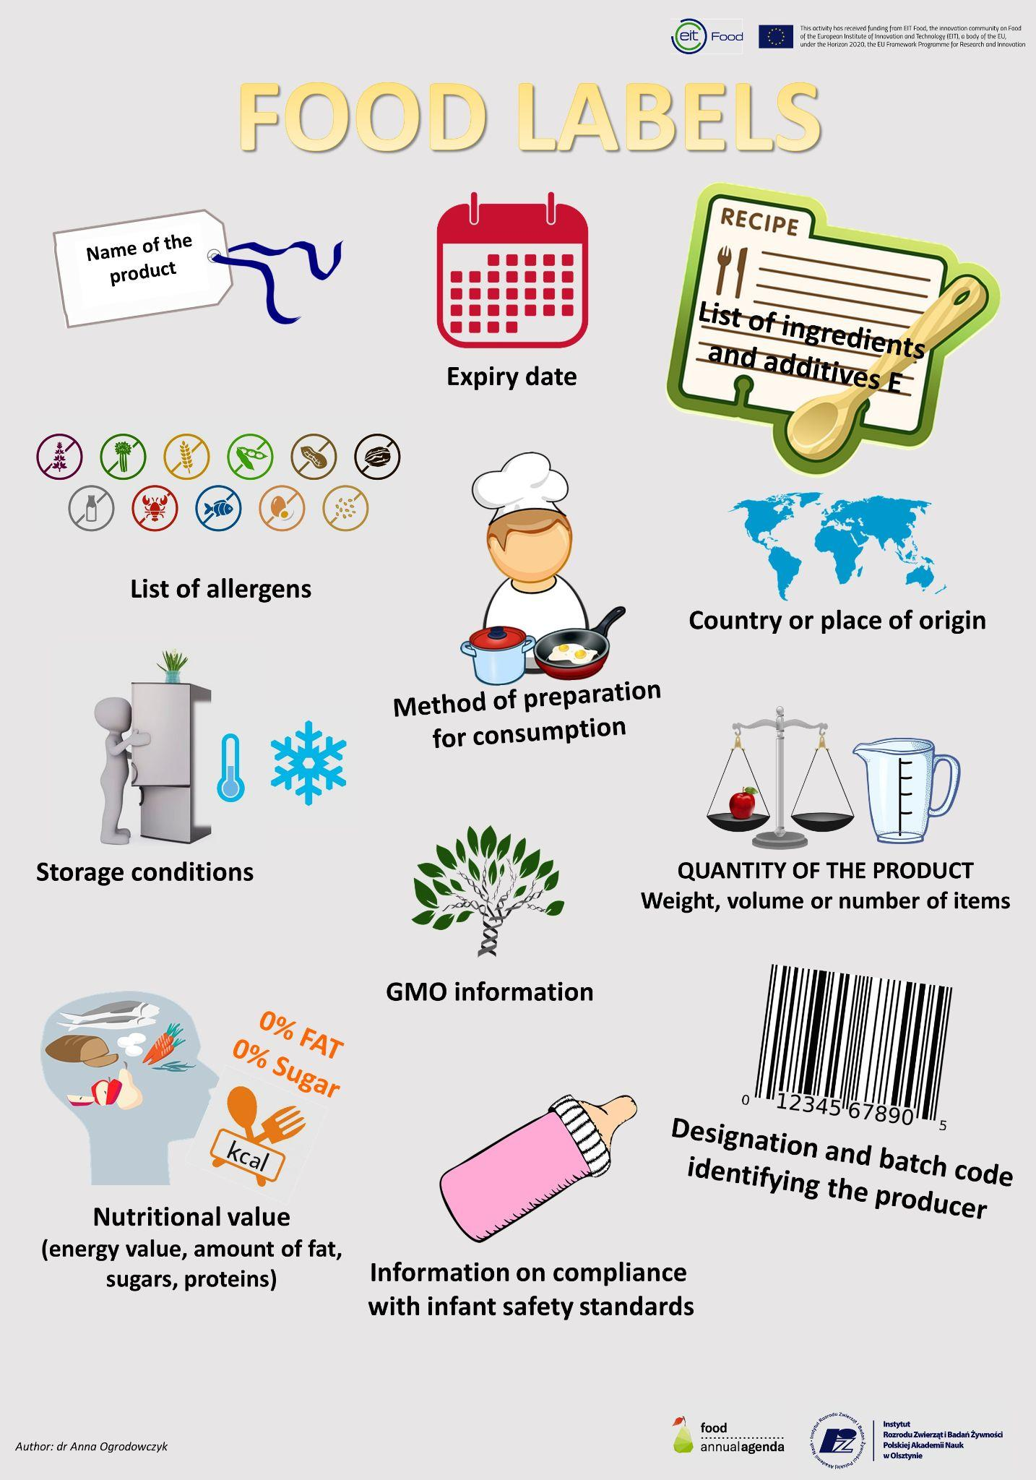
What’s on the package?
Details of the manufacturer, the marketing company and the company that packed the product, as well as the details of the importer and the country of production in the case of imported products
Weight or volume
List of ingredients
Nutritional labeling
Production date and expiration dates
Regulatory standards such as: "without" / "reduced ..." certain nutritional components and conditions for labeling a food product under the designations "natural" and "fresh".
Source: https://annualfoodagenda.com/

Slide 11
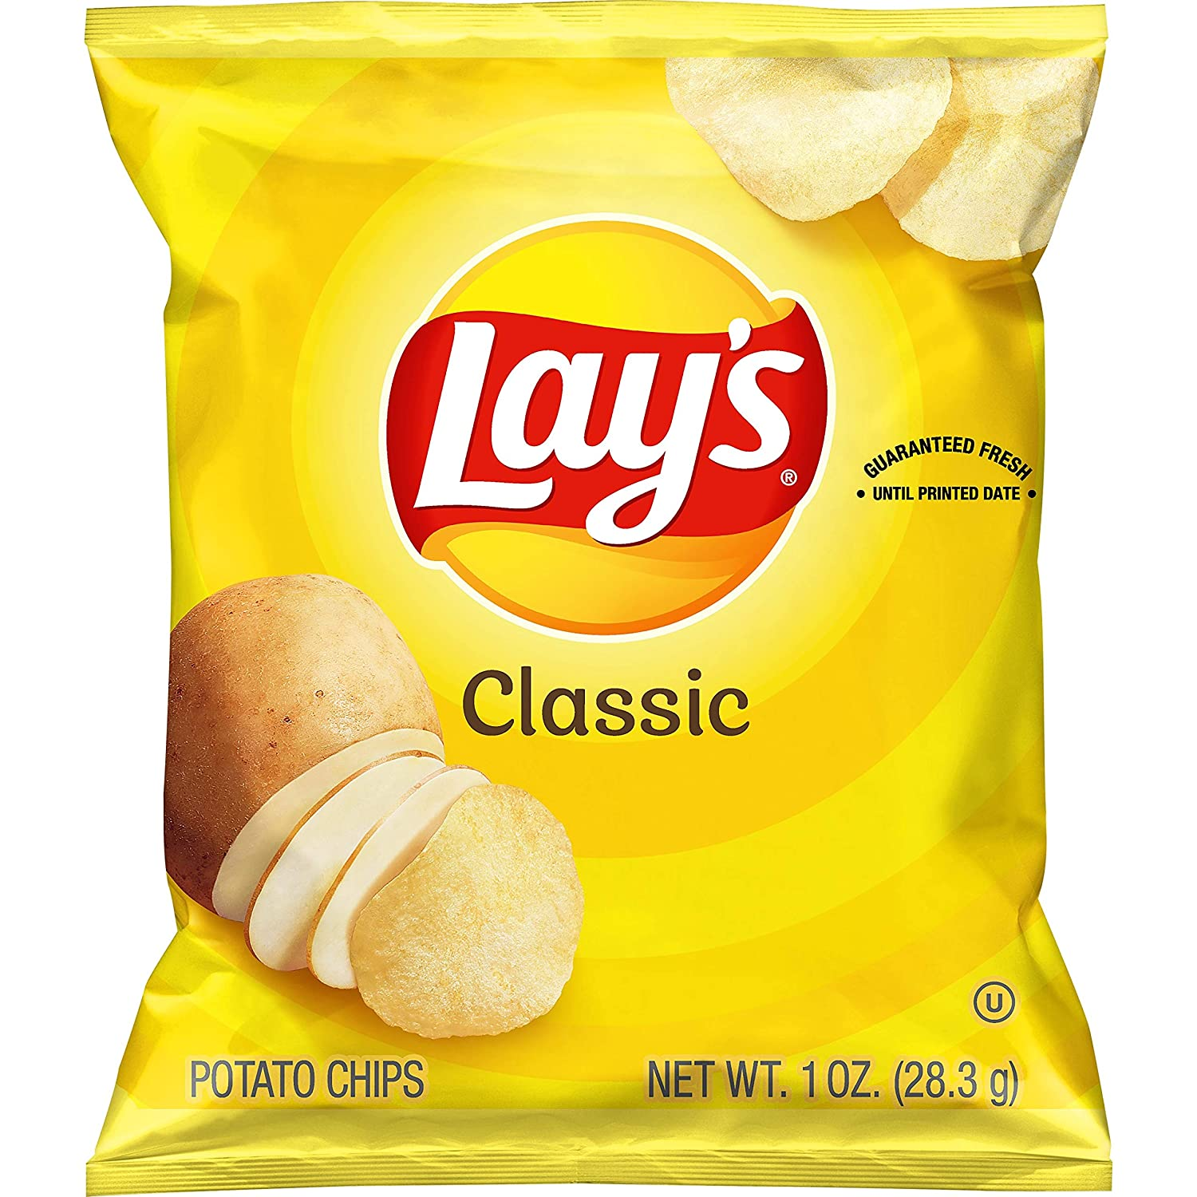
Product Name Vs. Food Name:
Product name: commercial name given to the food by the manufacturer for marketing purposes. This name does not necessarily represent the composition of the product and may be an imaginary name. For example:
Food name: Describes the essence of the product

Slide 12
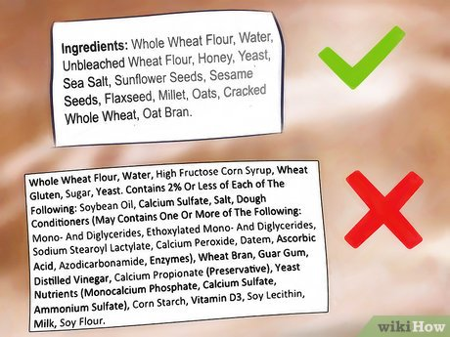
Ingredient List
The list includes all the ingredients in the product
The list is organised in a descending order - the first ingredient has the highest amount and so on
If the name of an ingredient is in the name of the product, its amount will be stated on the list. For example: Whole grain and rye bread

Slide 13
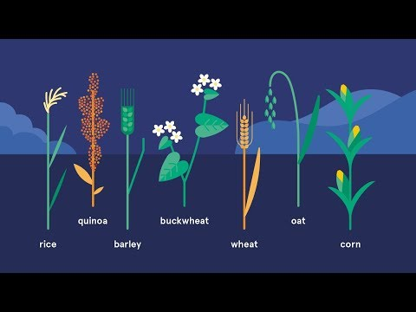
Are all whole-wheat breads created equal?
Image source: https://www.wikihow.com/Tell-if-Bread-Is-100-Percent-Whole-Wheat

Slide 14
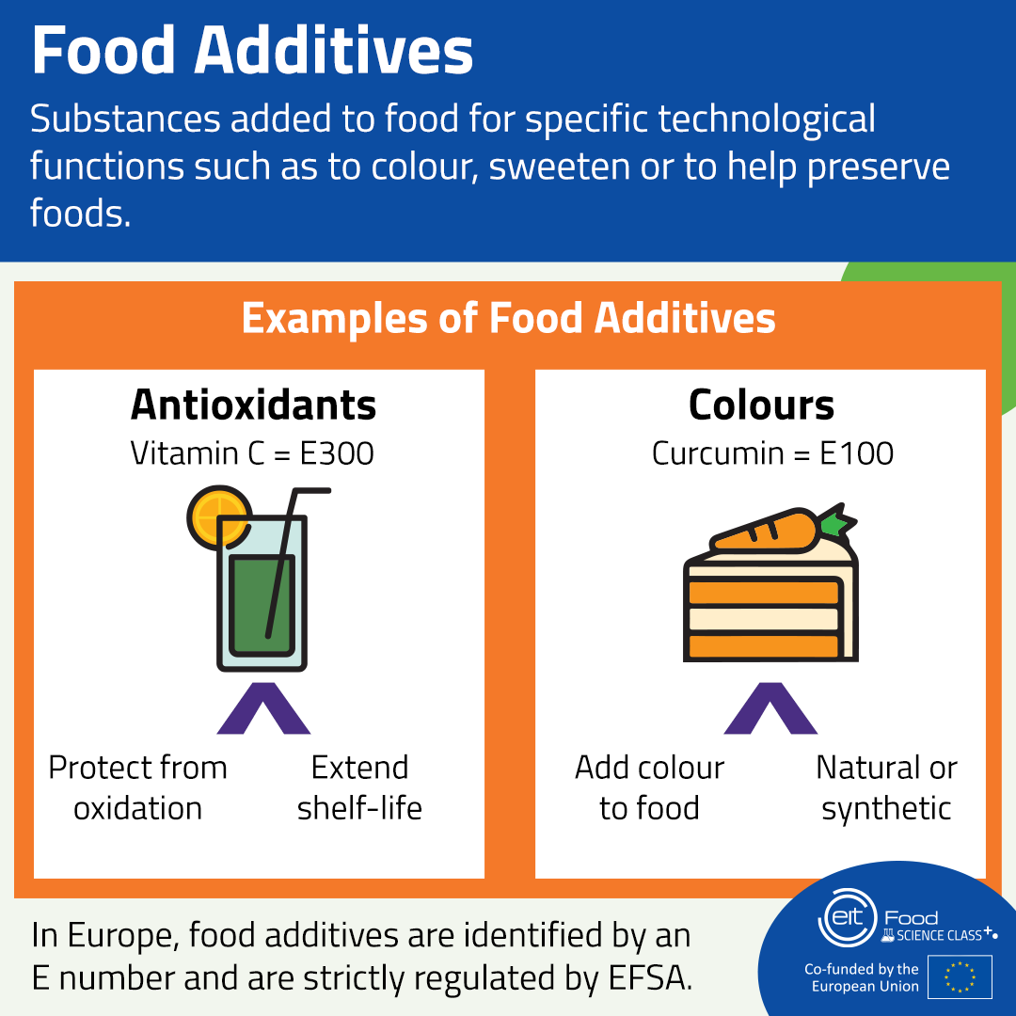
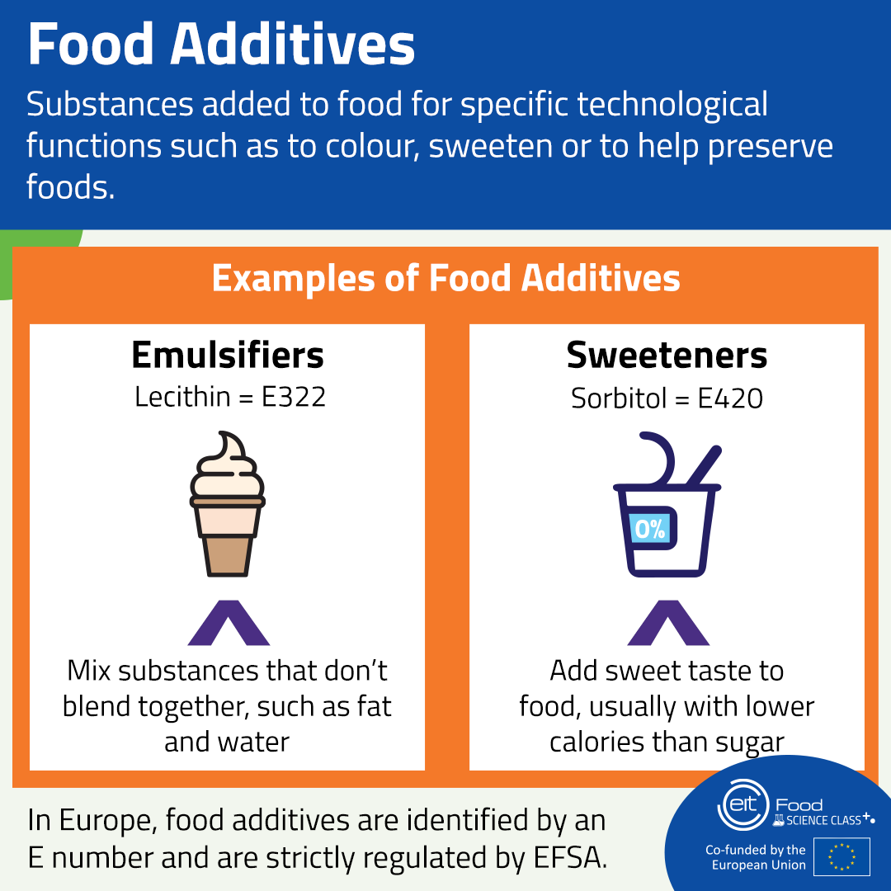
Food Additives - Different Kinds

Slide 15
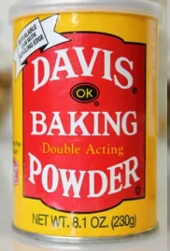
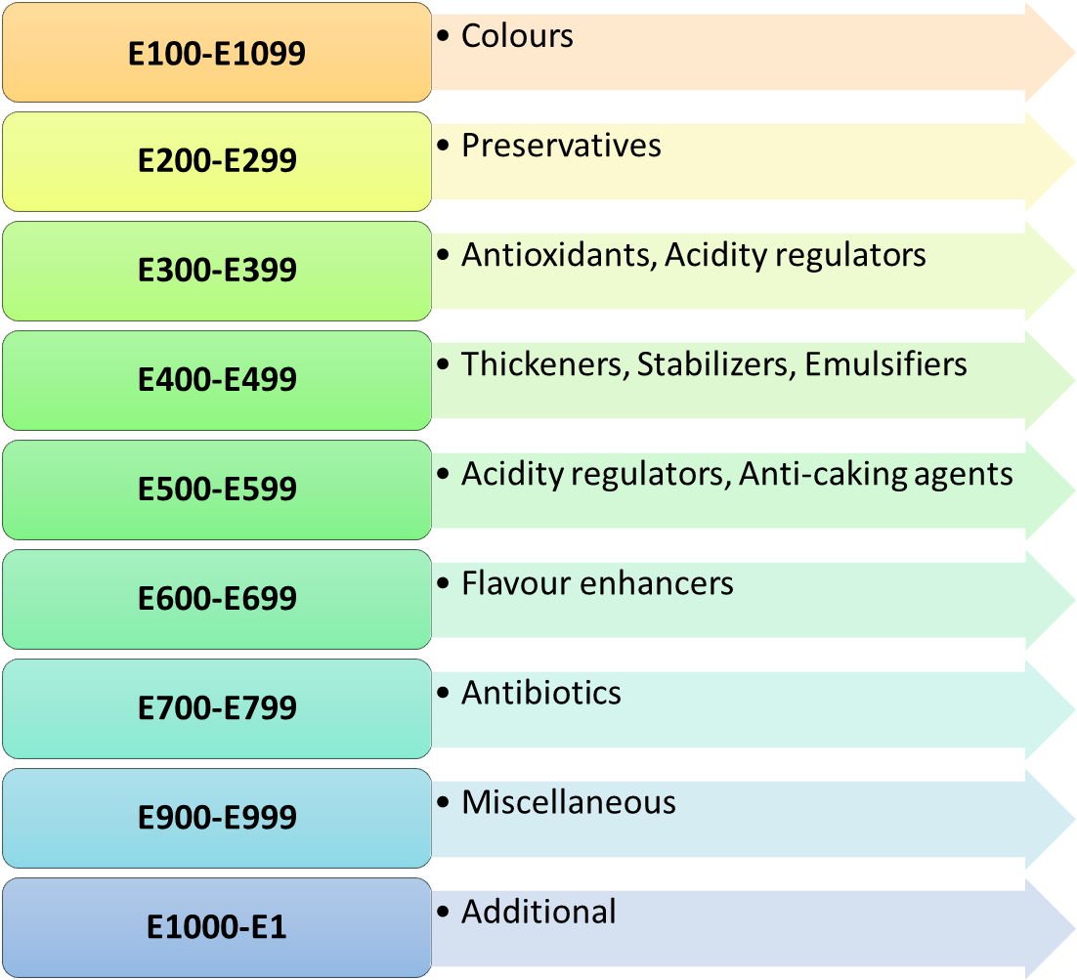
Food Additives - Regulatory Classifications
Image Source
1. The letter E with a number -E500. 2. A food additive name - sodium bicarbonate. 3. The function of the additive in the food- acidity regulator.

Slide 16
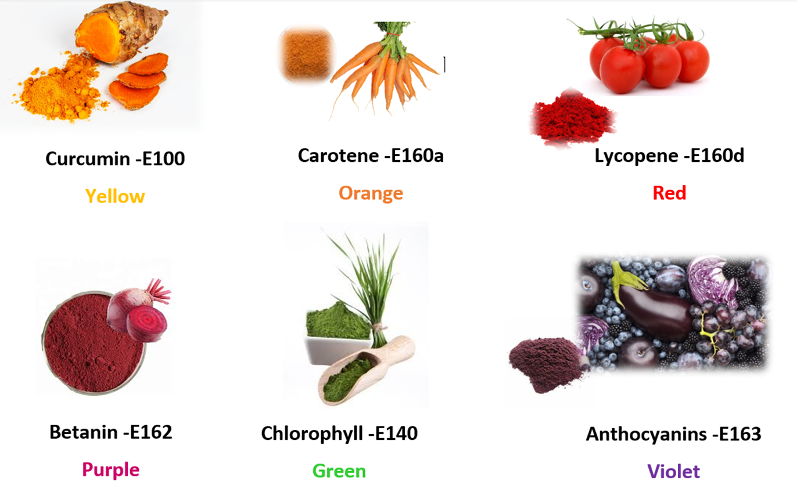
Food Additives - Food Colourings

Slide 17
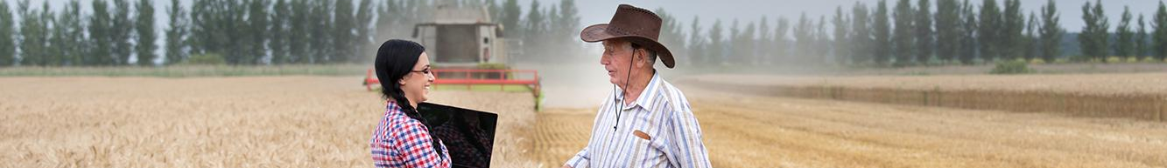
To summarise:
Manufacturers or importers are required to write down all the ingredients and materials present in the product
The ingredients must be written in descending order, according to their relative contents and the weight of the product
We can deduce the degree of processing of the food from the list of ingredients, especially the use of many additives: such as food colouring, preservatives, stabilisers, etc.

Slide 18
Nutrition Labeling
Food labels must show the following nutritional information:
Energy (kcal/KJ) content
Amount of fat, saturated fat, carbohydrate, sugar, protein and salt in 100g or 100ml of the product
Information on the amount per serving as well as the fibre, monounsaturated fat, polyunsaturated fat, polyol, starch and vitamin or mineral content may be included on an optional basis
Information often varies between countries and regions as local regulations and law vary.

Slide 19
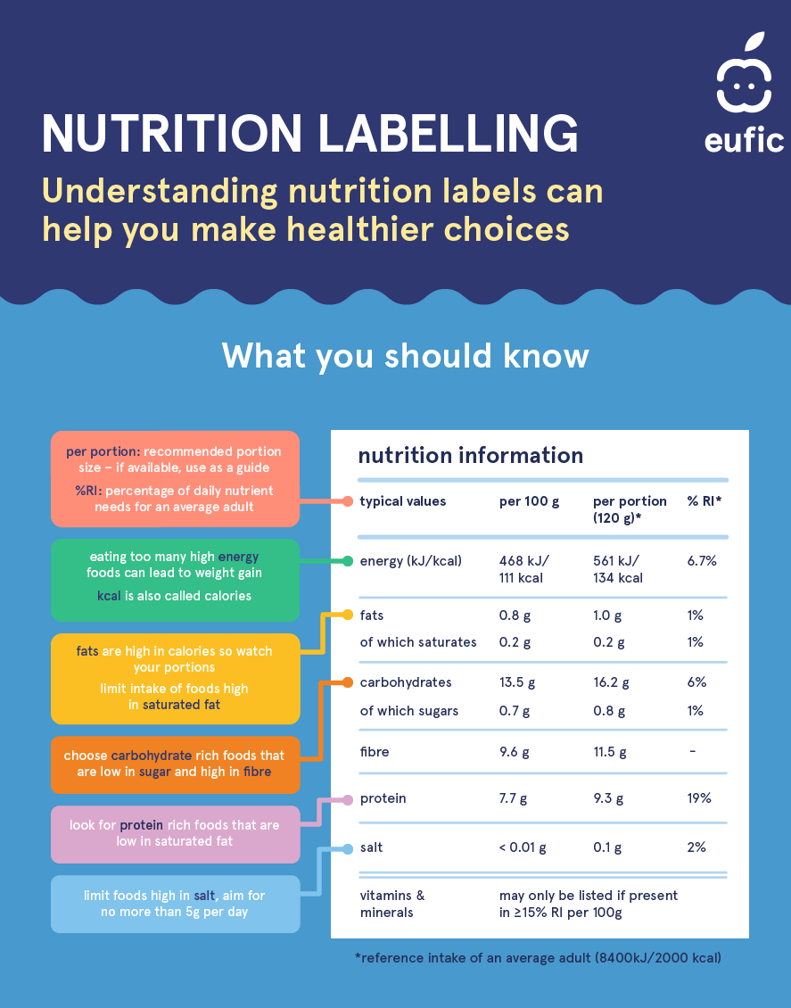
Nutrition Labeling Table
The table details the calorific value, the content of proteins, carbohydrates, fats and sodium.
Image Source: https://www.eufic.org/en/healthy-living/article/understanding-nutrition-information-infographic

Slide 20
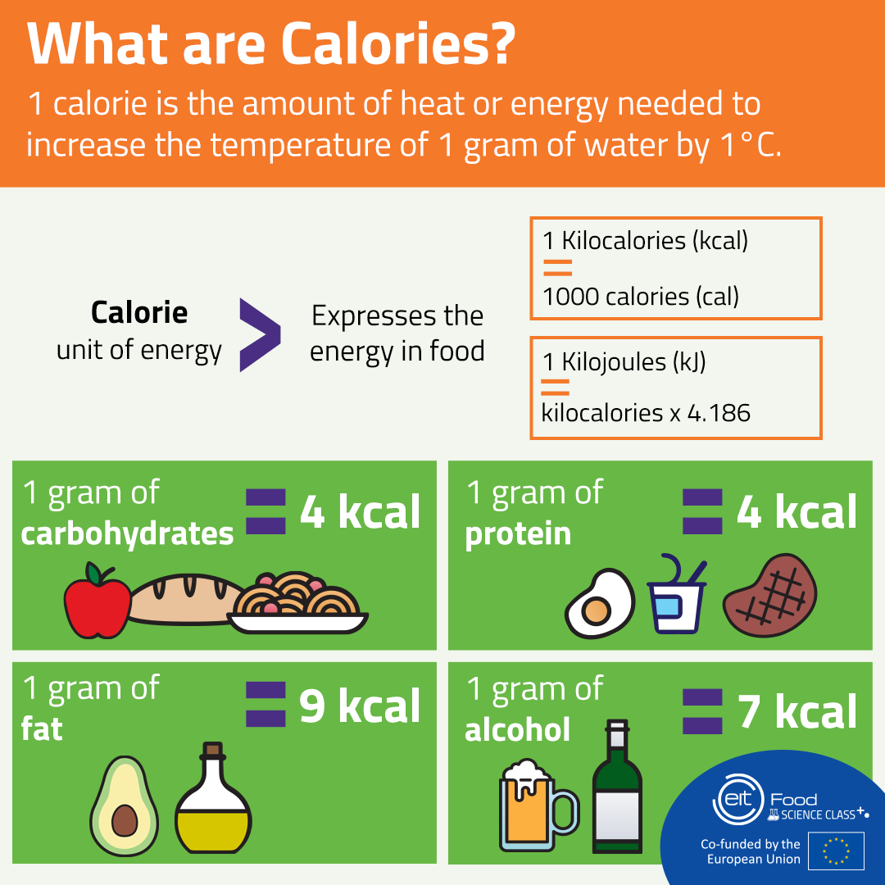

Slide 21
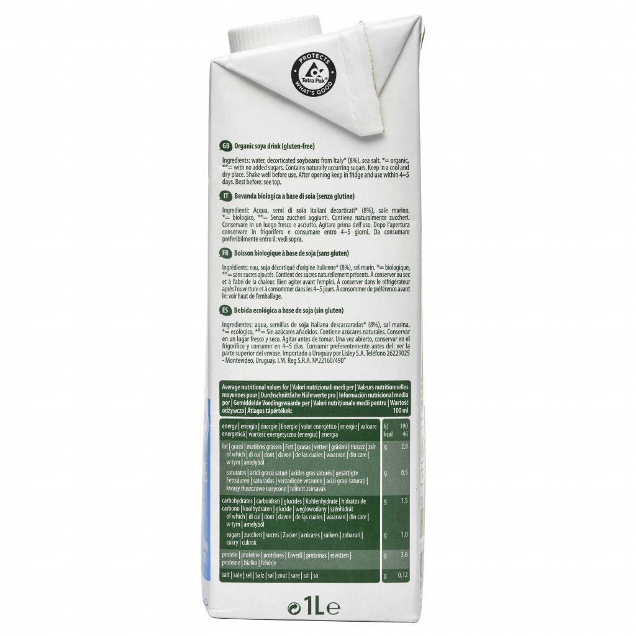
Nutritional Label - Calculating Calories
The calorific value is made up of carbohydrates (multiplied by 4), proteins (multiplied by 4), and fats (multiplied by 9)
Let’s take as an example soy drink (The brand is : The Bridge)

Slide 22
Nutritional Label
The calorific value is made up of carbohydrates (multiplied by 4), proteins (multiplied by 4), and fats (multiplied by 9)
In the product | Multiplied by | We get
1.5 grams of carbohydrates | 4 | 6 grams

Slide 23
Nutritional Label
The calorific value is made up of carbohydrates (multiplied by 4), proteins (multiplied by 4), and fats (multiplied by 9)
In the product | Multiplied by | We get
1.5 grams of carbohydrates | 4 | 6 grams
3.6 grams of protein | 4 | 14.4 grams

Slide 24
Nutritional Label
The calorific value is made up of carbohydrates (multiplied by 4), proteins (multiplied by 4), and fats (multiplied by 9)
In the product | Multiplied by | We get
3.6 grams of protein | 4 | 14.4 grams
1.5 grams of carbohydrates | 4 | 6 grams
2.8 grams of fat | 9 | 25.2 grams

Slide 25
Nutritional Label - Calculating Calories
Carbohydrates (multiplied by 4), proteins (multiplied by 4), and fats (multiplied by 9)
TOTAL: 45.6

Slide 26
Nutritional Label - Fats
Manufacturers are required to detail the level of cholesterol, saturated fat and trans fatty acids

Slide 27

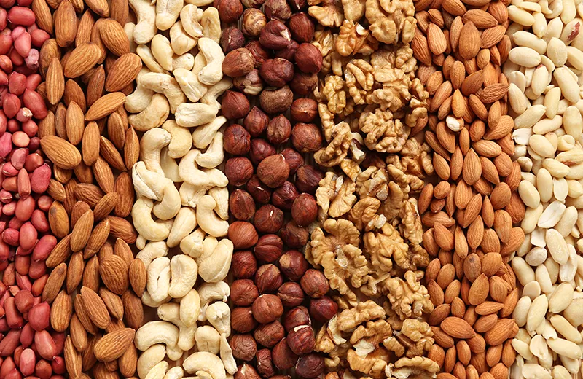
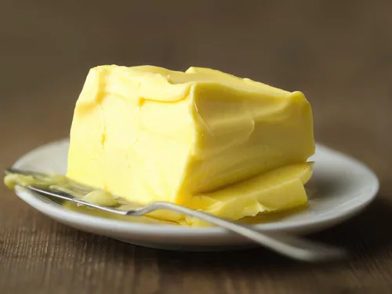
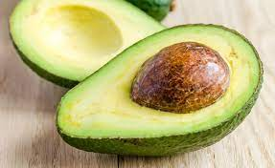
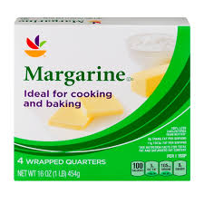
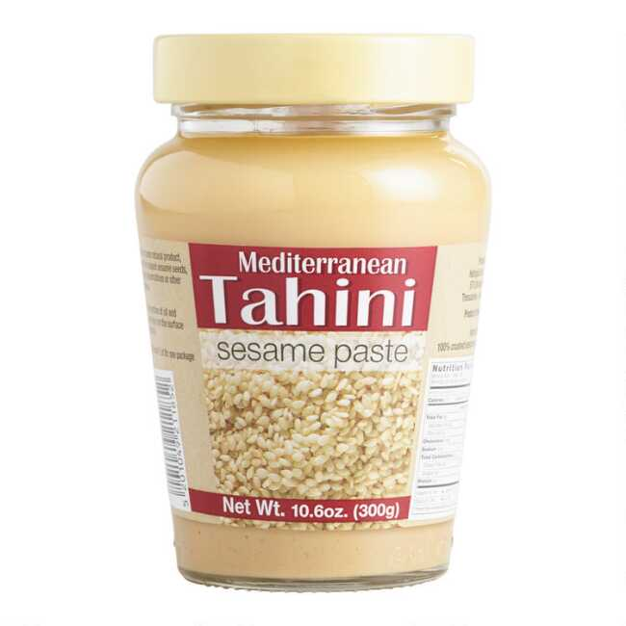
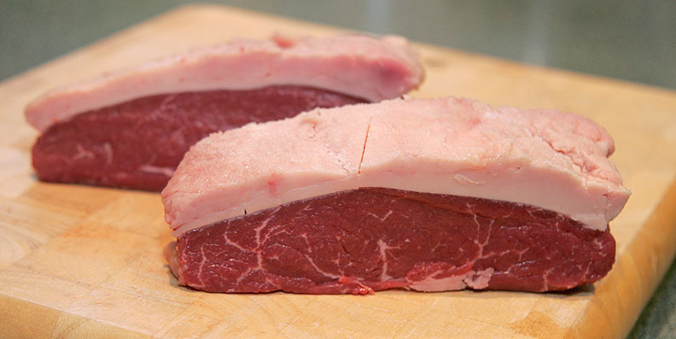
Fats
Fat
Unsaturated fat
(plant-based)
Saturated fat
(from animal source)

Slide 28
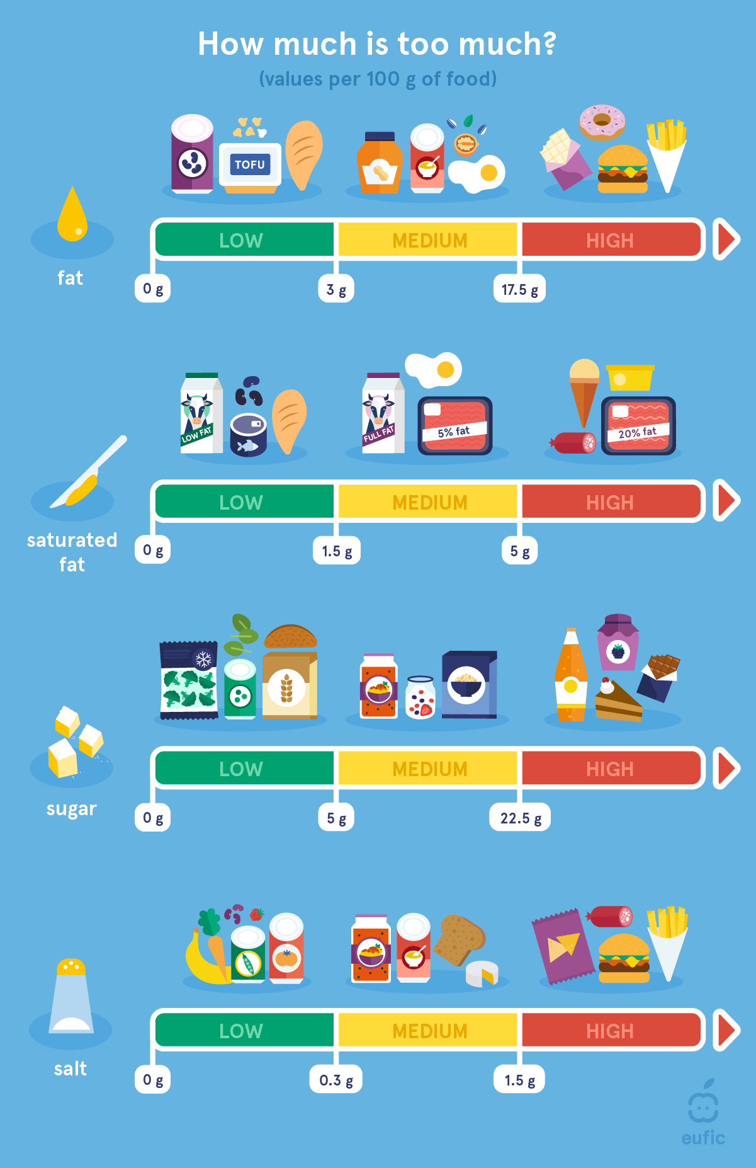
Making decisions based on nutrition labels
Image Source: https://www.eufic.org/en/healthy-living/article/understanding-nutrition-information-infographic

Slide 29
What’s on the package?
Details of the manufacturer, the marketing company and the company that packed the product, as well as the details of the importer and the country of production in the case of imported products
Weight or volume
List of ingredients
Nutritional labeling
Production date and expiration dates
Regulatory standards such as: "without" / "reduced ..." certain nutritional components and conditions for labeling a food product under the designations "natural" and "fresh".
Source: https://annualfoodagenda.com/

Slide 30
Deciphering Date Labels on Food Packages
The manufacturer is responsible to set the length shelf life of packaged food products ahead of time
The manufacturer decides how long the product is good for use and how long does it preserve its quality
Animal source food products such as meat, fish and eggs - their shelf life is decided and limited by law.

Slide 31
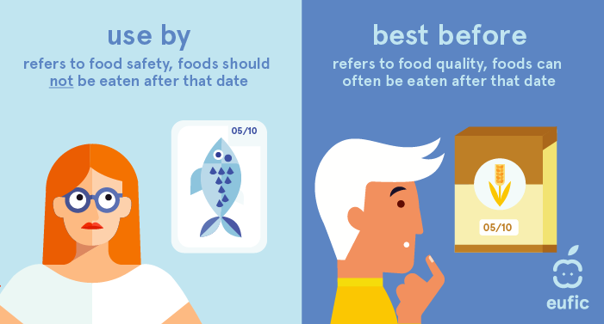
Commonly Used Labels
Image source: https://www.eufic.org/en/food-safety/article/best-before-use-by-and-sell-by-dates-explained

Slide 32
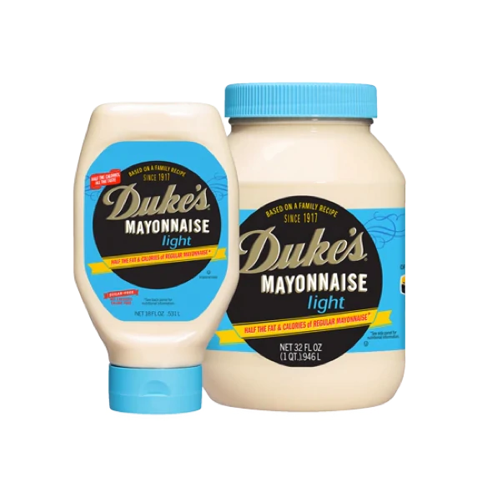
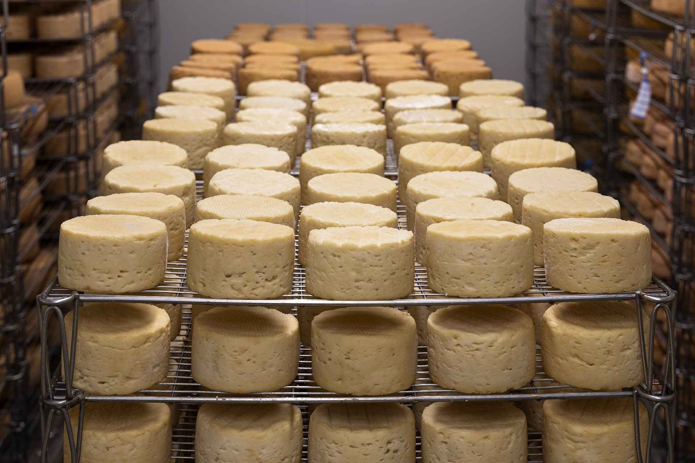
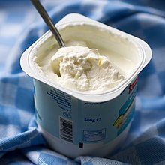
"Use By"
Food sensitive to antimicrobial spoilage can cause an immediate danger to your health
The words are followed the date by which the food remains safe for consumption or directions to where the date is printed on the package
It is best not to consume the food past the printed date

Slide 33
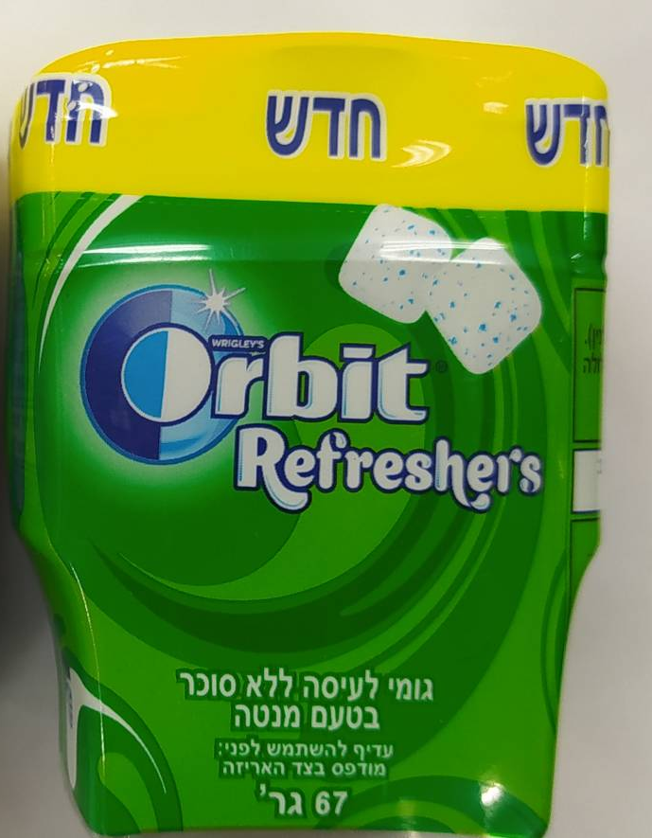
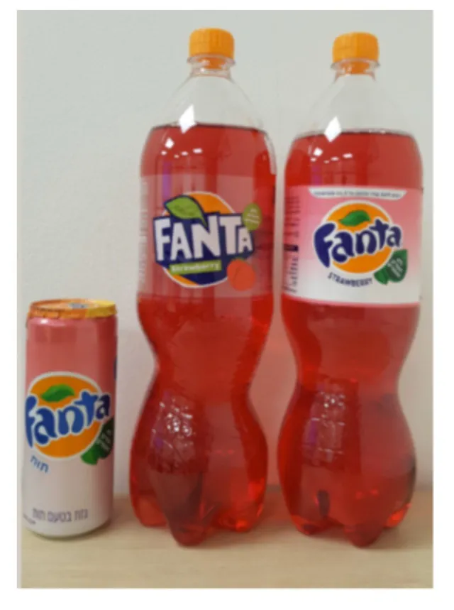
"Best Before"
Food that is not sensitive to antimicrobial spoilage
The words are followed by a date by which the food preserves its quality or directions to where the date is printed on the package
The date does not necessarily set when the product is no longer fit for use, but when there are changes in its quality

Slide 34
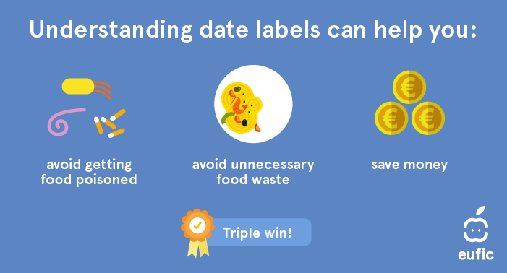
Source: https://www.eufic.org/en/food-safety/article/best-before-use-by-and-sell-by-dates-explained

Slide 35
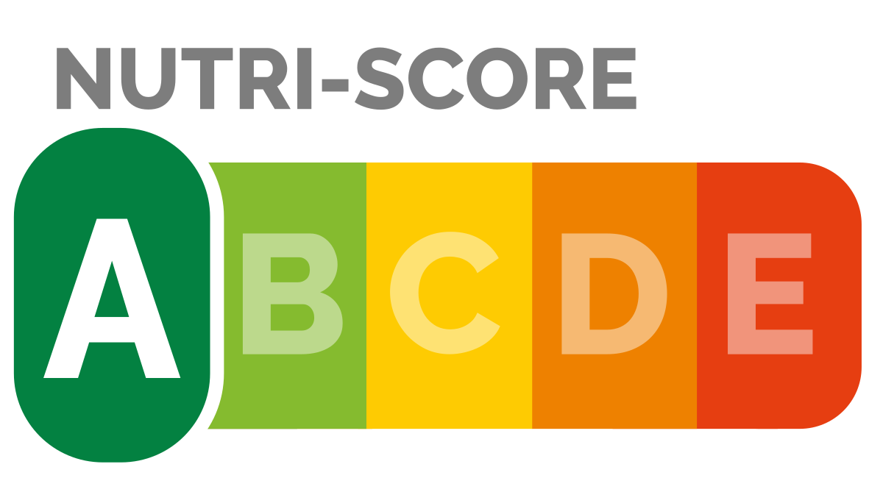
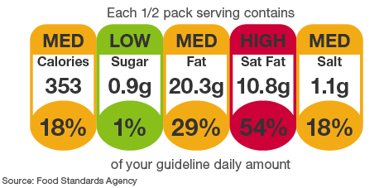




Front of package labels
Front of package labels (FOPL) are symbols found on the front side of the product
They can inform us about:
nutrient content
agriculture origin (organic, regional..)
special dietary requirements (vegetarian food, gluten free..)
EU decided to introduce harmonised FOPL system, which will be found on all packages sold in EU. The system should inform customers about the nutrient content of food, making the healthy and nutritious choice easier in practices
The discussions about the system of choice are ongoing, but among the favourites is the NUTRI-SCORE system, which is widely supported among scientist and healthcare and customer organisations
More information: https://www.europarl.europa.eu/legislative-train/theme-a-european-green-deal/file-mandatory-front-of-pack-nutrition-labelling https://www.iarc.who.int/news-events/nutri-score/

Slide 36
Food for Thought
One thing I learned about food labeling that I did not know before
One thing I learned about food labeling that I thought was the other way around
One thing I learned that I want to tell others about.

Slide 37
Thank you!

